Slide 1
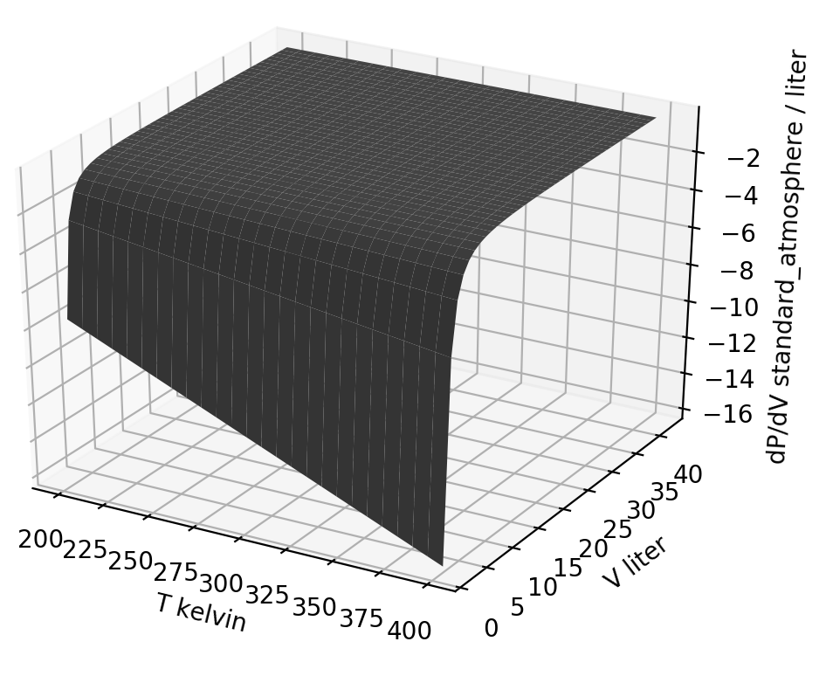
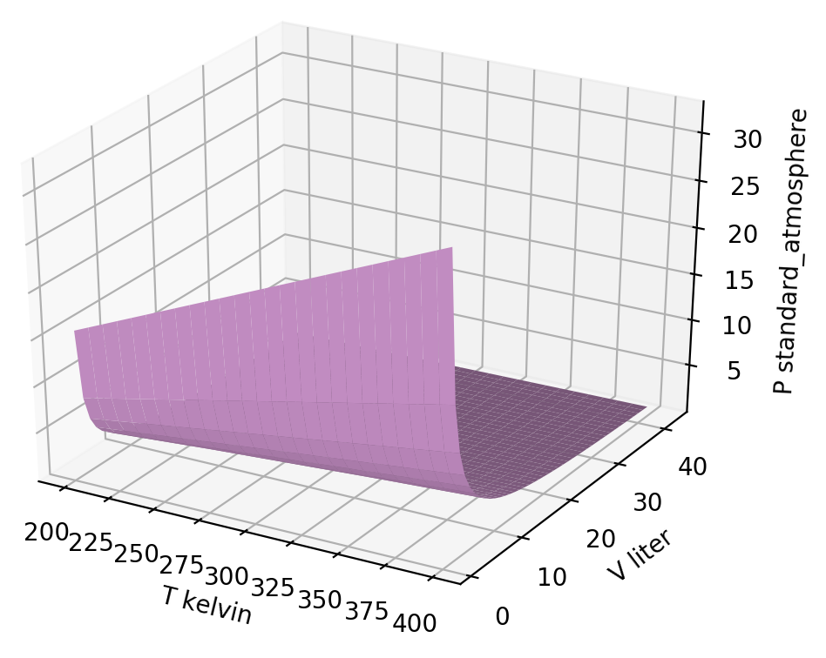
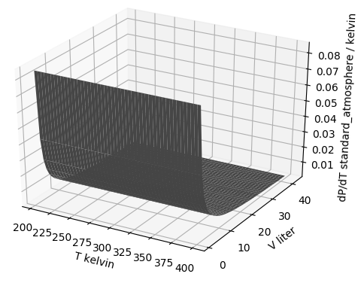



Thermodynamic surfaces of a gas - the big picture
${\left(\frac{∂P}{∂V}\right)}_{T}$
$$P\left(T,V\right)$$
${\left(\frac{∂P}{∂T}\right)}_{V}$

Slide 2
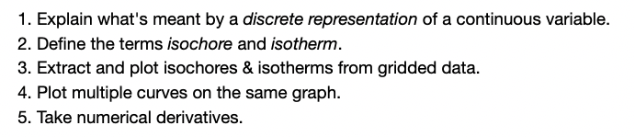
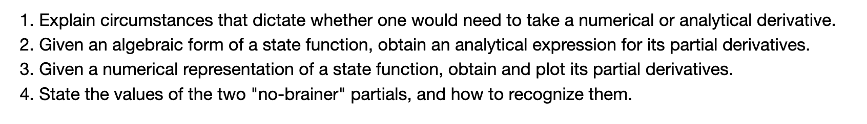
Thermodynamic surfaces of a gas - the goals
Learning Goals (Wednesday)
Learning Goals (Thursday)

Slide 3
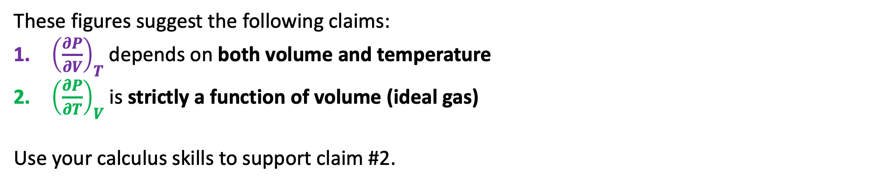
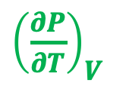
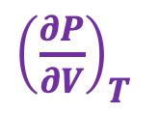
Analytical challenge #1: How ${\left(\frac{∂P}{∂V}\right)}_{T}$ and ${\left(\frac{∂P}{∂T}\right)}_{V}$ depend on temperature and volume
Here are slopes of the pressure of an ideal gas, depicted as thermodynamic surfaces:
${\left(\frac{∂P}{∂V}\right)}_{T}$
${\left(\frac{∂P}{∂T}\right)}_{V}$
These figures suggest the following claims:
${\left(\frac{∂P}{∂V}\right)}_{T}$ depends on both volume and temperature
${\left(\frac{∂P}{∂T}\right)}_{V}$ is strictly a function of volume (ideal gas)
Use your calculus skills to support claim #2.

Slide 4
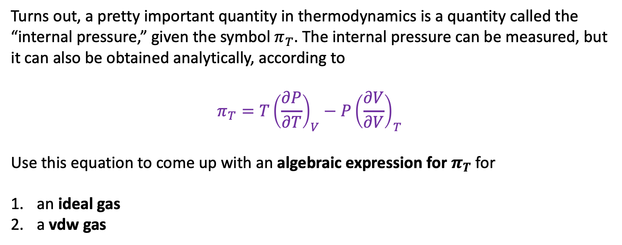
Analytical challenge #2: Derivation of $π_{T}$
Turns out, a pretty important quantity in thermodynamics is a quantity called the “internal pressure,” given the symbol $π_{T}$. The internal pressure can be measured, but it can also be obtained analytically, according to
$$π_{T}=T{\left(\frac{∂P}{∂T}\right)}_{V}−P{\left(\frac{∂V}{∂V}\right)}_{T}$$
Use this equation to come up with an algebraic expression for $π_{T}$ for
an ideal gas
a vdw gas

Slide 5
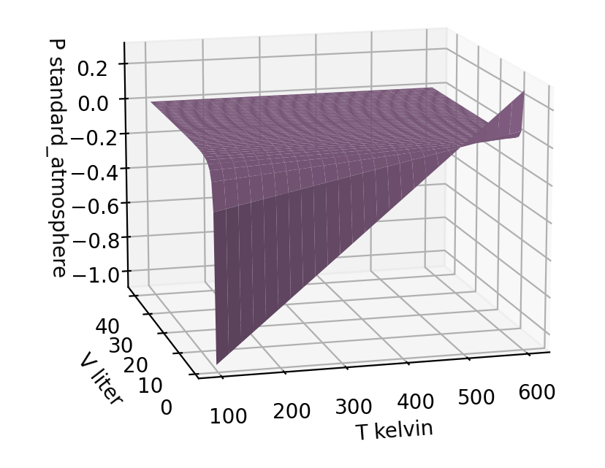
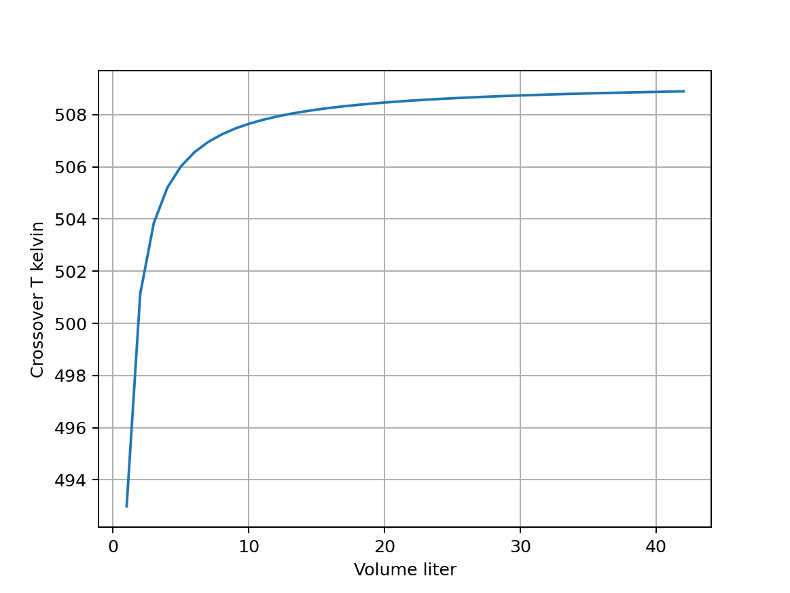
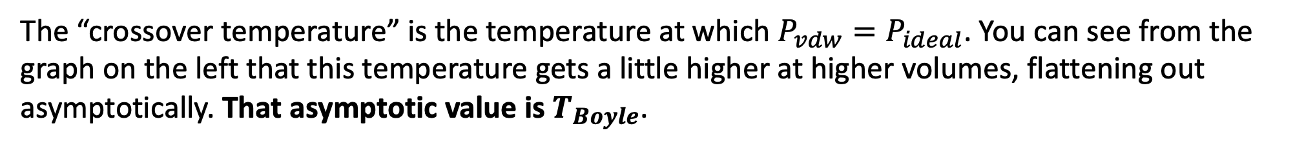

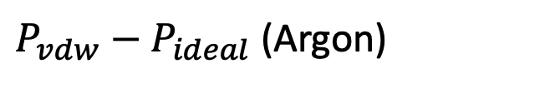
Analytical challenge #3: Return to the Boyle temperature
The “crossover temperature” is the temperature at which $P_{vdw}=P_{ideal}$. You can see from the graph on the left that this temperature gets a little higher at higher volumes, flattening out asymptotically. That asymptotic value is $T_{Boyle}$.
$P_{vdw}−P_{ideal}$ (Argon)
$$T_{Boyle}$$
Obviously, $T_{Boyle}$(the asymptotic limit) is volume-independent. But what exactly does it depend on? There are two options available to you.

Slide 6

Option A: The algebraic limit method
Solve $P_{vdw}=P_{ideal}$for $T$. Then, manipulate your expression for $T$into a form in which it’s obvious how to take the limit $V→big$.
$$T_{Boyle}$$

Slide 7
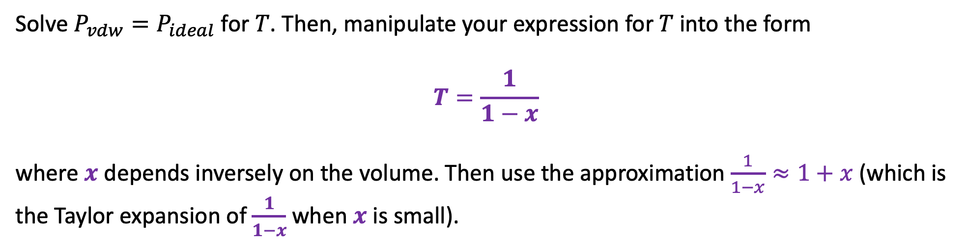
Option B: The Taylor expansion method
Solve $P_{vdw}=P_{ideal}$for $T$. Then, manipulate your expression for $T$into the form
$$T=\frac{1}{1−x}$$
where $x$ depends inversely on the volume. Then use the approximation $\frac{1}{1−x}≈1+x$ (which is the Taylor expansion of $\frac{1}{1−x}$ when $x$ is small).

